Slide 1
Donation Trends of CA Campaigns, 2011-2016
Asha Dhakad and Rithika Devarakonda
Notes:
Rithika

Slide 2
Outline of Presentation
01
02
03
04
05
06
Introduction
Literature Review
Expectations
Research Design
Discussion
Conclusion
Network Visualizations and Modularity Results, CDA Results, Descriptive Statistics, Network Regression Results
Notes:
Rithika

Slide 3
Introduction
Polarization is increasing in many aspects of politics
Networks of the top 50 donors to California's House and Senate campaigns, 2011-2016
Which industries donate to which parties? Are these networks becoming more polarized?
Data is aggregate donations to California’s state legislative House and Senate elections 2011-2016 where actors are donors and edges mean both donated to the same political candidate from National Institute on Money in Politics (NIMP)
Notes:
Asha

Slide 4
Literature Review
Why California: influential, wealthy blue state with a wealth gap
Labor groups mostly donate to Democrats, while business groups mostly donate to Republicans
Networks of interest group campaign donors have been found to be polarized
Past research supports both of our theories
Notes:
Asha

Slide 5
Expectations
Expectation 1
Polarization increases as years progress in how donors donate to campaigns, as donors will be consistent to one political party
Higher level of network modularity (more ingoing ties than outgoing ones); communities formed by party affiliations
Expectation 2
Republican donors = financial, business, and agricultural groups and party affiliated committees
Democratic donors = labor groups, the public health sector, and grassroots organizations
Both will have closer networks, or more ties with each other
Notes:
Rithika

Slide 6
Research Design
Modularity
Optimal Community Detection Algorithm
Higher modularity score: community detection algorithm was more successful in isolating the various sub-communities bolstered by the inherent structure of shared ties between donors in our entire network
Top 50 donors who contributed over 50% of their funds to either party
Probability Matrix
Network Regression
Frequency of ties present between Health, Labor, Finance & Real Estate, Business, and Agriculture groups separated into Democrat and Republican matrices to see difference influences of industry among donor circles
DV: if ties exist
IV: continuous variables: PerDem difference, PerRep difference, absolute difference in total contributions + binary variable if same group
Finds tangible results to determine if donors formed ties which means backing the same candidate, based on whether or not they came from the same industry, had similar total contributions, and had similar percent breakdowns of their funds donated to either party
Notes:
Asha
Also, the formulated communities amongst the most influential donors lead us to investigate our second motivating question regarding the importance of donors sharing similar traits such as industry categorization as well as overall financial contributions in forming ties.
In order to understand how the majority of ties were formed across the five categories isolated above, we decided to create a probability matrix that displayed the proportion of a tie being present between any one pairing, such as Agriculture-Agriculture compared to Agriculture-General Business. Our twelve probability matrices are based on a single electoral year for both the House and Senate races from 2011-16 in which a higher numerical value represented a higher level of ties between two of the four groups: Health, Labor, Finance and Real Estate, General Business, and Agriculture, including ties between the same categories. There is a Democrat probability matrix that isolates the distribution of ties between categories of those who donated over 50% to Democratic candidates and one that likewise is reflective of those who donated over 50% to Republican candidates.
The binary dependent variable is if ties exist in the form of an adjacency matrix which as stated above represent whether any two actors supported the same candidate in any given House or Senate race. We made stacked adjacency matrices for the independent variables (continuous variables: PerDem difference, PerRep difference, absolute difference in total contributions + binary variable if same group) for network regression model across all six datasets to ensure we have all actors who belong to our groups. To test if having the same group matters in forming ties and if groups had political affiliations, we included these combinations: Health and Labor (for Democratic ties), General Business and Agriculture (for Republican ties), and Finance and Real Estate (for Democratic and Republican ties). Finance and Real Estate was placed to test the party affiliation as a metric of comparison as the “neutral” industry.
Asha

Slide 7
Network Visualization and Modularity Results
Notes:
Rithika

Slide 8
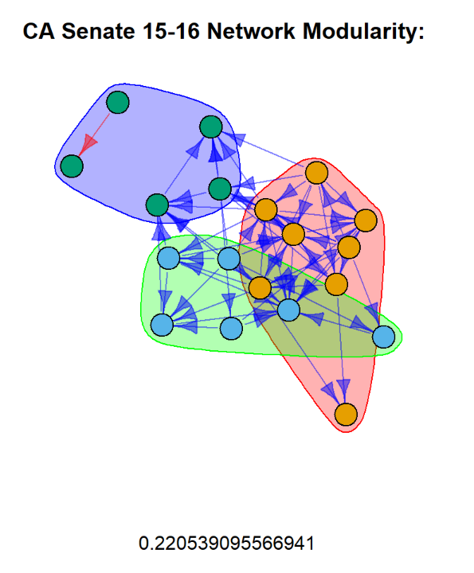
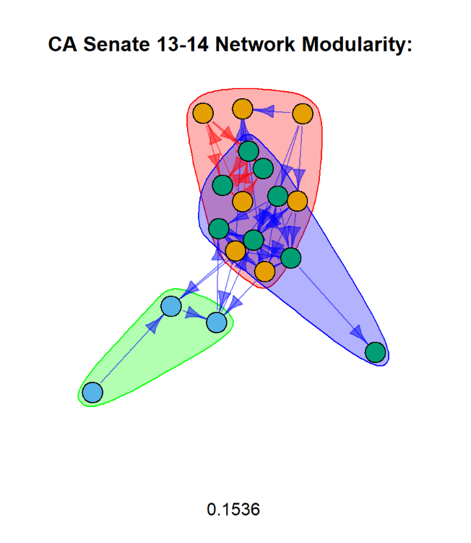
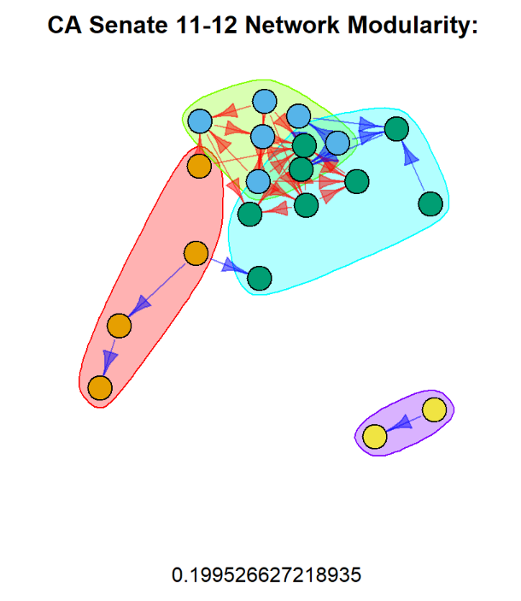
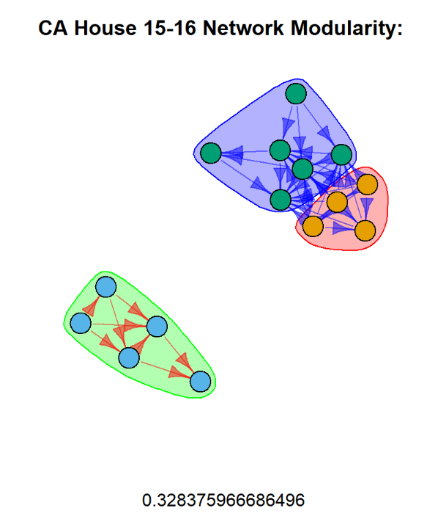
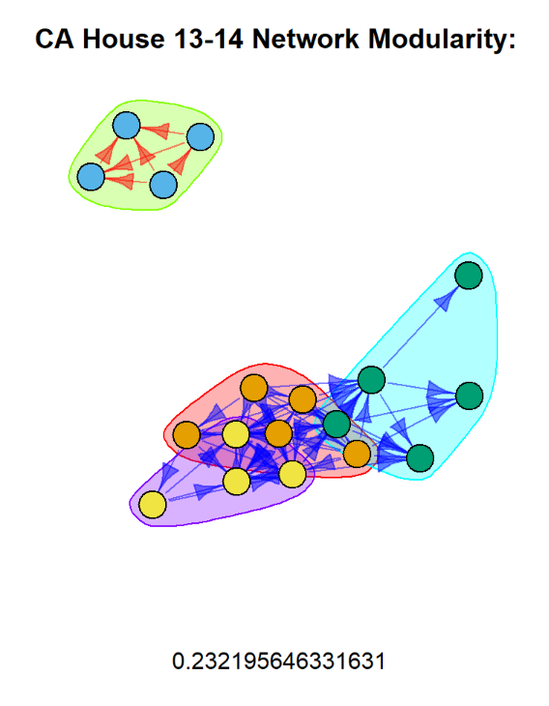
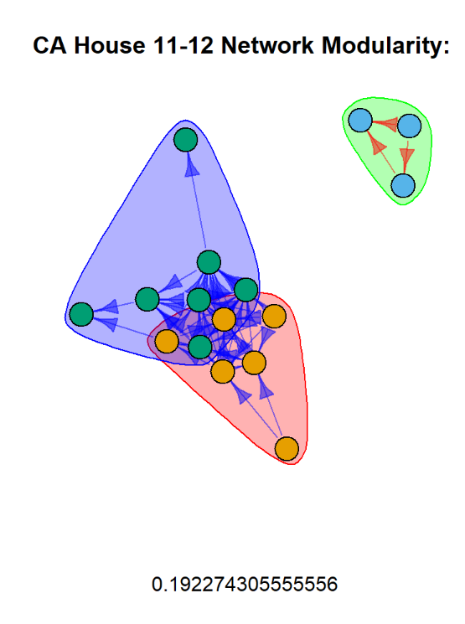
Notes:
Graphs - Rithika

Slide 9
Modularity and Community Detection Algorithm Results
Networks became more polarized between 2011 and 2016
2 separate networks: a Democratic and a Republican one
Democratic networks are closely connected; Republican network is only one community
Modularity increased in the House networks; so did number of Republican donors
Both the House and Senate donor networks increased in polarization
Modularity in the Senate network was constant
Within the larger Democratic party, there were other subgroups present due to other factors
Notes:
Rithika

Slide 10
Descriptive Statistics: Proportion Matrix Results

Slide 11
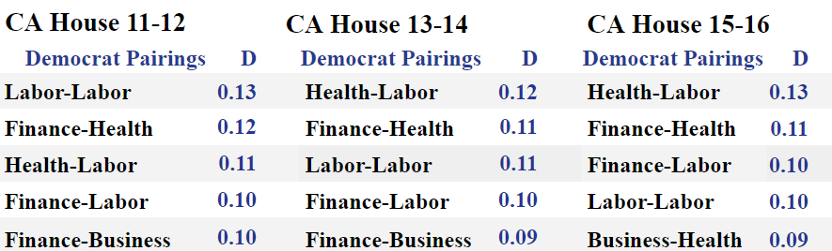
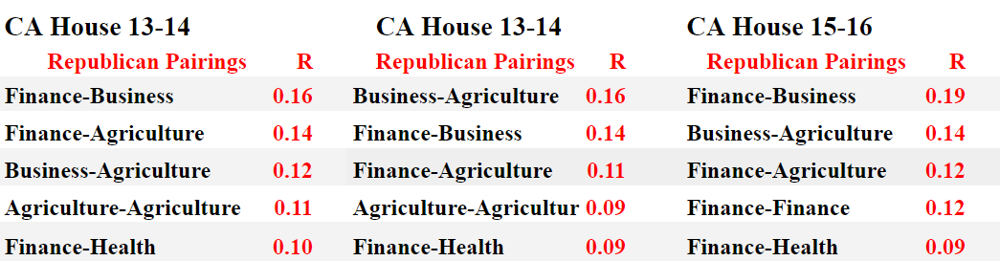
The top five most frequent pairings for the Democratic party for California House 2011-16
The top five most frequent pairings for the Republican party for California House 2011-16
Notes:
Rithika

Slide 12
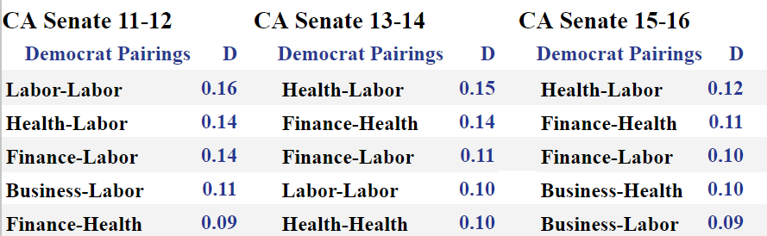
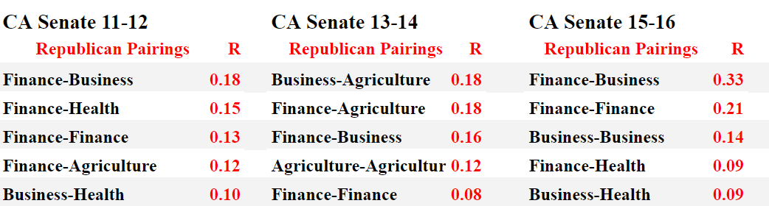
The top five most frequent pairings for the Democratic party for California Senate 2011-16
The top five most frequent pairings for the Republican party for California Senate 2011-16

Slide 13
Descriptive Statistics Results: House
Democratic House donor network is more diverse than Republican one
Top Democratic pairings: Labor-Labor (11-12), Health-Labor (13-14), Health-Labor (15-16)
Top Republican pairings: Finance-Business (11-12), Business-Agriculture (13-14), Finance-Business (15-16)
Business-Health was prominent in 2015-2016
Highest proportion was Finance-Business in 2015-2016
Consistent Democratic donors: Health and Labor groups
Consistent Republican donors: Business, Finance, and Agriculture groups
Notes:
Asha

Slide 14
Descriptive Statistics Results: Senate
Democratic Senate donor network is more diverse than Republican one
Top Democratic pairings: Labor-Labor (11-12), Health-Labor (13-14), Health-Labor (15-16)
Top Republican pairings: Finance-Business (11-12), Business-Agriculture (13-14), Finance-Business (15-16)
Highest proportion was Finance-Business in 2015-2016
Consistent Democratic donors: Health and Labor groups
Consistent Republican donors: Business and Finance groups
Decreased prominence of Agriculture groups in 2015-2016 especially in the Senate race

Slide 15
Network Regression Results

Slide 16
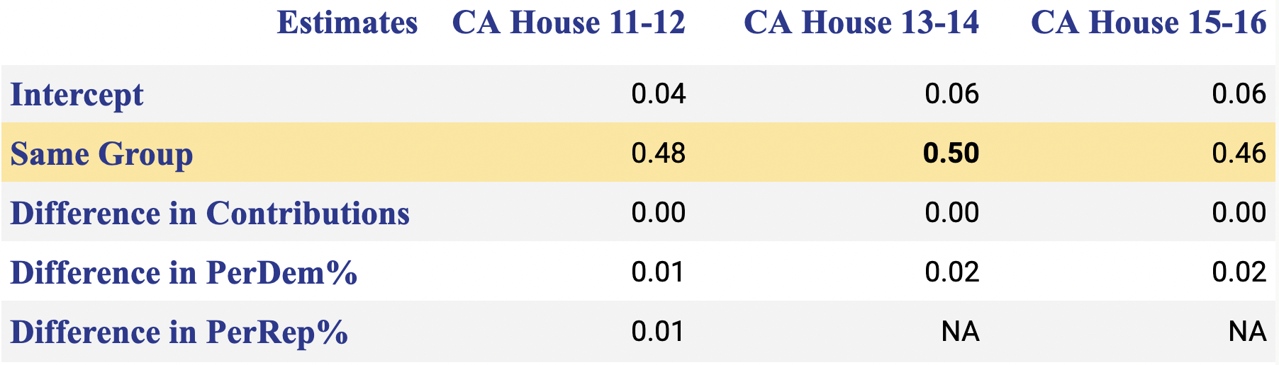
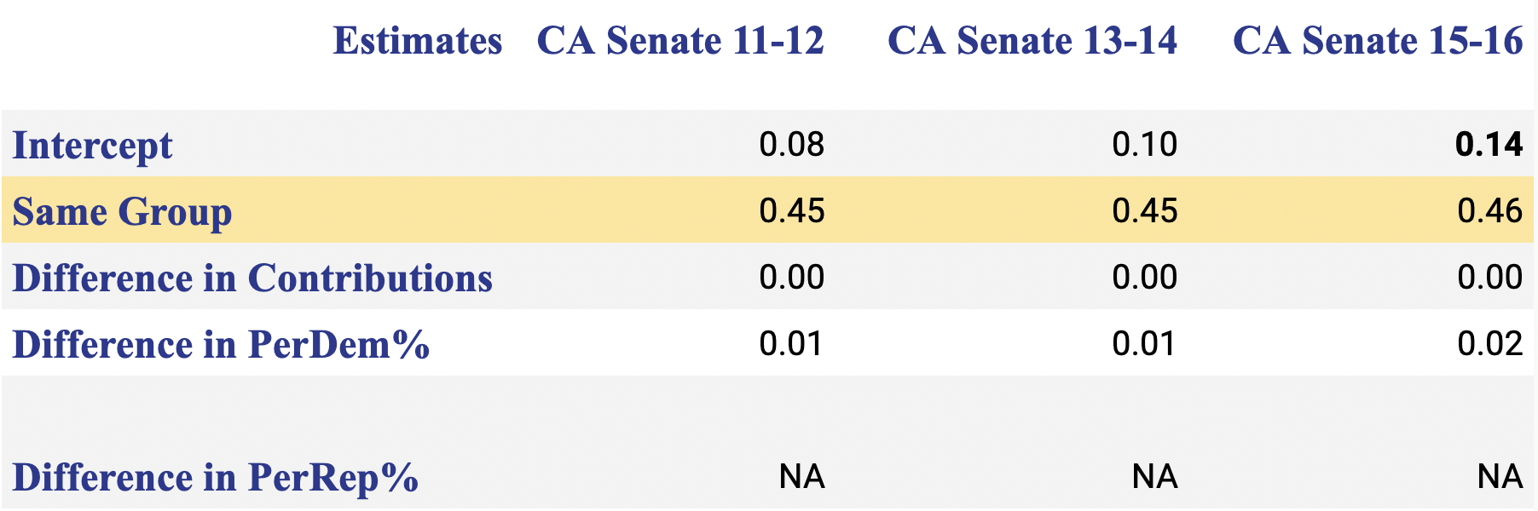
Network Regression Model Estimates for California House 2011-16
and
California Senate 2011-16
Notes:
Asha

Slide 17
Network Regression Results
Dependent variable: if ties exist in an adjacency matrix
Independent variables: perDem difference, perRep difference, absolute difference in total contributions, binary variable; also in adjacency matrices
When 2 donors are of the same industry, they're more likely to have a tie
Used both an ERGM and netlogit
45-50% higher likelihood of 2 donors in the same group funding the same candidates
No Republican majority industry; most donors were in Health + Labor groups
Majority of top donors come from political or party orgs
Party affiliations run so deep in our chosen groups
Small donors cling to larger, more influential donors

Slide 18
Conclusion/Further Research
Polarization has increased → proved first hypothesis
Donors from the same industry were connected because they donated to the same candidates
Health and Labor groups were consistent Democratic donors; Business and Finance groups were consistent Republican donors → proved second hypothesis
Studying donor networks is important because it gives insight into donor motivations
This paper furthers past research on interest group donation trends
Future research: might study a less dominant-party state, or do a comparative analysis
Notes:
Rithika

Slide 19
Sources
Apkarian, Jacob, et al. “Donor Motivations in the California State Legislature: A Social Network Analysis of Campaign Contributions.” Connections, vol. 35, no. 1, Jan. 2015.
Brunell, Thomas L. “The Relationship between Political Parties and Interest Groups: Explaining Patterns of PAC Contributions to Candidates for Congress.” Political Research Quarterly, vol. 58, no. 4.
“Community Detection - neo4j Graph Data Science.” Neo4j Graph Data Platform.
Gimpel, James G., et al. “Business Interests and the Party Coalitions: Industry Sector Contributions to US Congressional Campaigns.” American Politics Research, vol. 42, no. 6, 2014.
Grossmann, Matt, and Casey B. Dominguez. “Party Coalitions and Interest Group Networks.” American Politics Research, vol. 37, no. 5, 2009.
Heaney, Michael, et al. "Polarized Networks: The Organizational Affiliations of National Party Convention Delegates." American Behavioral Scientist, vol. 56, no. 12, 2012, pp. 1654-1676.
Malbin, Michael J.. "Small Donors: Incentives, Economies of Scale, and Effects" The Forum, vol. 11, no. 3, 2013, pp. 385-411.
Neal, Zachary. "A Sign of the Times? Weak and Strong Polarization in the US Congress, 1973-2016." Social Networks, vol. 60, pp. 103-112.
Reuning, Kevin. “Mapping Influence: Partisan Networks across the United States, 2000 to 2016.” State Politics & Policy Quarterly, vol. 20, no. 3, 2020, pp. 267–291.
Robbins, Suzanne M., and Maksim Tsvetovat. "Guns, Babies and Labor: Campaign Finance Networks in the 2000 Elections (working draft)." Southern Illinois University Carbondale, 2008. Political Networks Paper Archive.
Wouters, Olivier J. “Lobbying Expenditures and Campaign Contributions by the Pharmaceutical and Health Product Industry in the United States, 1999-2018.” JAMA Internal Medicine, vol. 180, no. 5, 3 Mar. 2020.

